Slide 1
Financial Fraud Detection
Notes:
Hackathon Presentation

Slide 2
Problem Statement
Predict fraudulent transactions
Anomaly detection in transactions
Notes:
Can we include some examples here?
Here explain in a single line or two, what is the problem you are solving.
What could be the possible business problems that are related to the data science problem you are solving?

Slide 3
Why solve this problem?
Prevent customer from possible fraud
Add a security layer for customers to gain more customer confidence
Reduce company costs w.r.t. Claims and arbitration
Stakeholders
Risk management team with CTO
Assumptions
Steps converted to hours (Eg. step =1, hour = 12am to 1am)
Notes:
Why solving this problem is important? - Business Impact
Who are the stakeholders for whom you are presenting the solution? - CEO, CFO, Marketing, Sales etc
Any important assumptions you are making.

Slide 4
Data
step - maps a unit of time in the real world. In this case 1 step is 1 hour of time. Total steps 744 (31 days simulation).
type - CASH-IN, CASH-OUT, DEBIT, PAYMENT and TRANSFER.
amount - amount of the transaction in local currency.
nameOrig - customer who started the transaction
oldbalanceOrg - initial balance before the transaction
newbalanceOrig - new balance after the transaction
nameDest - customer who is the recipient of the transaction
oldbalanceDest - initial balance recipient before the transaction. Note that there is not information for customers that start with M (Merchants).
newbalanceDest - new balance recipient after the transaction. Note that there is not information for customers that start with M (Merchants).
isFraud - This is the transactions made by the fraudulent agents inside the simulation. In this specific dataset the fraudulent behavior of the agents aims to profit by taking control or customers accounts and try to empty the funds by transferring to another account and then cashing out of the system.
isFlaggedFraud - The business model aims to control massive transfers from one account to another and flags illegal attempts. An illegal attempt in this dataset is an attempt to transfer more than 200.000 in a single transaction.
Notes:
What are the data points you currently have in the dataset?
If you had the opportunity, what additional data you would love to have?
You currently have all the data you need available to you a csv, however in real life thats NEVER going to be the case. You will be requesting, extracting the data from multiple different sources. Though we are sharing the data with you, take sometime to think about all the different sources of data that you will need access from the bank’s context to put together this kind of dataset eventually. This should be a key insight on your final report

Slide 5
Exploratory Data Analysis
Notes:
Put across the EDA that is most interesting and relevant to the problem.
For each of the Data visualizations being showcased, put the business relevant insight, and bring out how are you using this insight later in problem solving.
Put the most insightful 2-3 data visualizations and rest of EDA summarize. Let jupyter notebook stay as is, this is a crisp summary ONLY

Slide 6
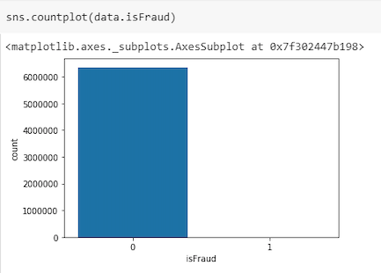
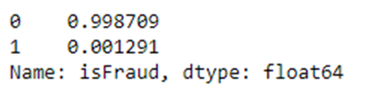
Data imbalance
Notes:
Put across the EDA that is most interesting and relevant to the problem.
For each of the Data visualizations being showcased, put the business relevant insight, and bring out how are you using this insight later in problem solving.
Put the most insightful 2-3 data visualizations and rest of EDA summarize. Let jupyter notebook stay as is, this is a crisp summary ONLY

Slide 7
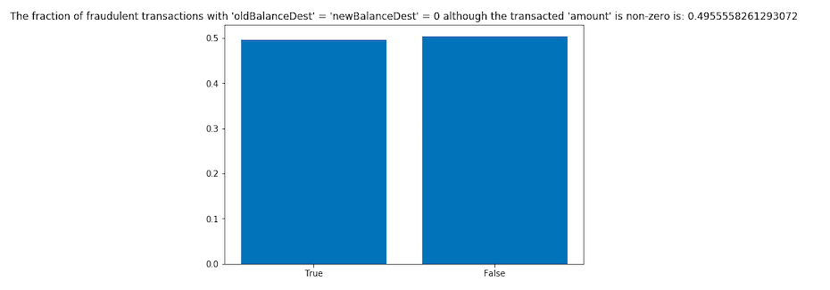
Fraud transaction :
oldBalanceDest = newBalanceDest = 0 & transacted amount is NON ZERO
Notes:
Put across the EDA that is most interesting and relevant to the problem.
For each of the Data visualizations being showcased, put the business relevant insight, and bring out how are you using this insight later in problem solving.
Put the most insightful 2-3 data visualizations and rest of EDA summarize. Let jupyter notebook stay as is, this is a crisp summary ONLY

Slide 8
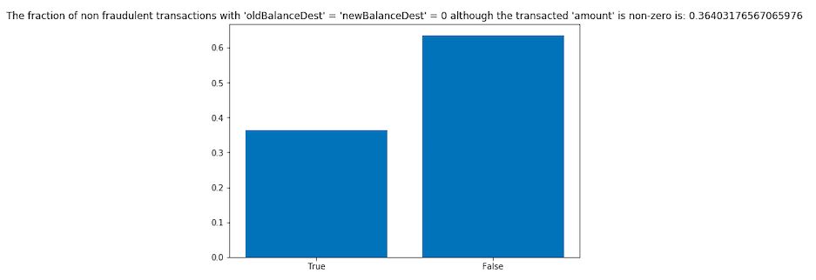
Non - Fraudulent transaction :
oldBalanceDest = newBalanceDest = 0 & transacted amount is NON ZERO
Notes:
Put across the EDA that is most interesting and relevant to the problem.
For each of the Data visualizations being showcased, put the business relevant insight, and bring out how are you using this insight later in problem solving.
Put the most insightful 2-3 data visualizations and rest of EDA summarize. Let jupyter notebook stay as is, this is a crisp summary ONLY

Slide 9
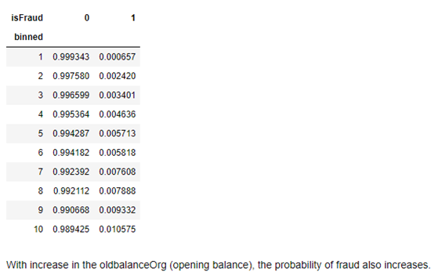
Binned the opening balance :
More the opening balance
=
More the chances of
fraudulent transaction
Notes:
Put across the EDA that is most interesting and relevant to the problem.
For each of the Data visualizations being showcased, put the business relevant insight, and bring out how are you using this insight later in problem solving.
Put the most insightful 2-3 data visualizations and rest of EDA summarize. Let jupyter notebook stay as is, this is a crisp summary ONLY

Slide 10
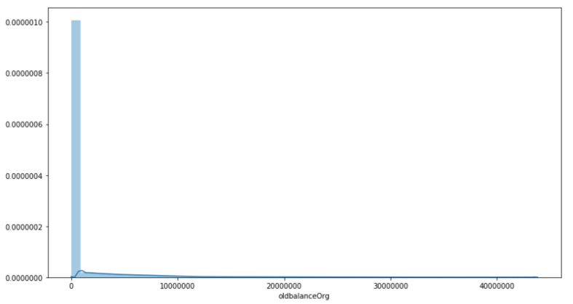
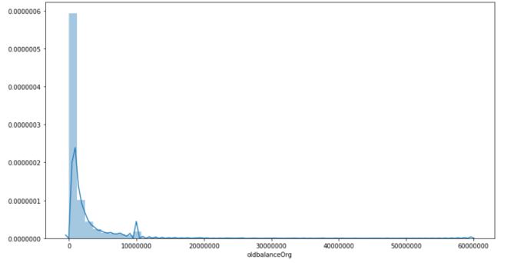
Distribution of opening balance amount
Non Fraud (opening balance)
Fraud (opening balance)
Notes:
Put across the EDA that is most interesting and relevant to the problem.
For each of the Data visualizations being showcased, put the business relevant insight, and bring out how are you using this insight later in problem solving.
Put the most insightful 2-3 data visualizations and rest of EDA summarize. Let jupyter notebook stay as is, this is a crisp summary ONLY

Slide 11
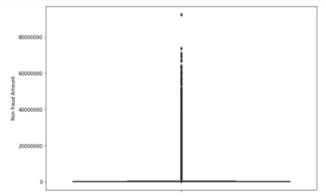
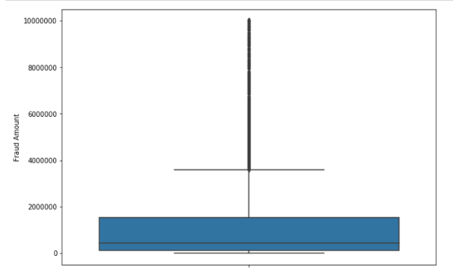
Distribution of amount column
Non Fraud (amount)
Fraud (amount)
Notes:
Put across the EDA that is most interesting and relevant to the problem.
For each of the Data visualizations being showcased, put the business relevant insight, and bring out how are you using this insight later in problem solving.
Put the most insightful 2-3 data visualizations and rest of EDA summarize. Let jupyter notebook stay as is, this is a crisp summary ONLY

Slide 12
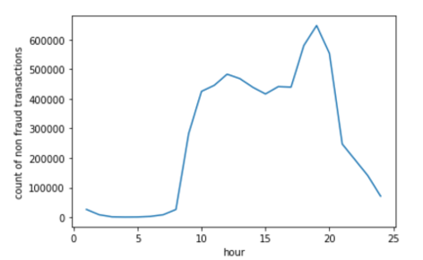
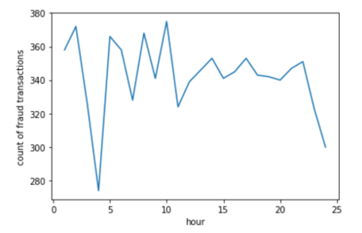
Distribution of hour column
Non Fraud (hour)
Fraud (hour)
Notes:
Put across the EDA that is most interesting and relevant to the problem.
For each of the Data visualizations being showcased, put the business relevant insight, and bring out how are you using this insight later in problem solving.
Put the most insightful 2-3 data visualizations and rest of EDA summarize. Let jupyter notebook stay as is, this is a crisp summary ONLY

Slide 13
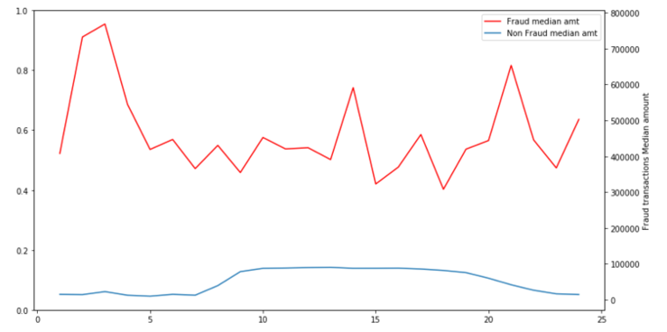
Classification of Fraud vs Non Fraud Median transfer amount w.r.t. Hour of the day
Notes:
Put across the EDA that is most interesting and relevant to the problem.
For each of the Data visualizations being showcased, put the business relevant insight, and bring out how are you using this insight later in problem solving.
Put the most insightful 2-3 data visualizations and rest of EDA summarize. Let jupyter notebook stay as is, this is a crisp summary ONLY

Slide 14
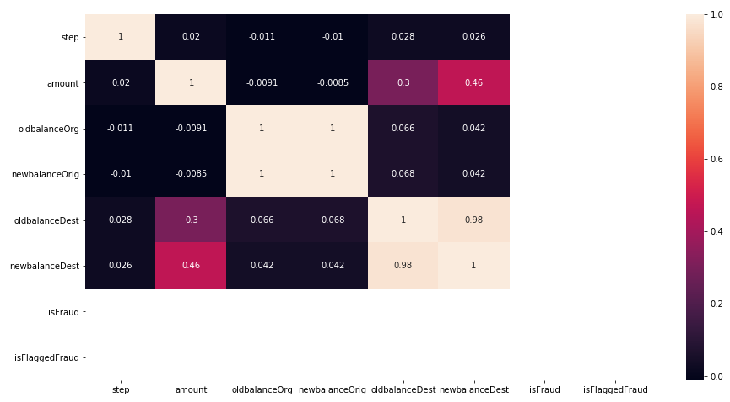
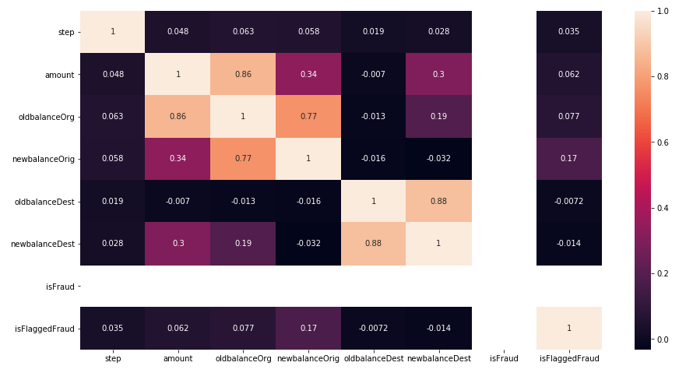
Correlation between features
Non Fraud
Fraud
Notes:
Put across the EDA that is most interesting and relevant to the problem.
For each of the Data visualizations being showcased, put the business relevant insight, and bring out how are you using this insight later in problem solving.
Put the most insightful 2-3 data visualizations and rest of EDA summarize. Let jupyter notebook stay as is, this is a crisp summary ONLY

Slide 15
Exploratory data analysis
isFlaggedFraud column seems to be ambiguous/unclear
Minimum Transaction amount which is flagged as fraud is 353874.22
Maximum Transaction amount which is not flagged as fraud is 92445516.64
The definition of “isFlaggedFraud” column doesn’t hold true for majority of transaction.
That makes that feature insignificant.

Slide 16
Feature Engineering
Error Amount at Origin = New Balance at Origin + Amount – Old Balanace Origin
Error Amount at Destination = Old Balance Origin + Amount – New Balance Destination
These two can also be added features.

Slide 17
Feature Engineering
Feature Engineering to find out customer spending patterns columns
median_amt_debit: median of amount deducted from each Origin account.
mean_amt_debit: average amount deducted from Origin Accounts.
median_amt_received: median of amount received in Destination Accounts.
mean_amt_received: average of amount received in Destination Accounts.
No_of_transactions: Number of Transactions initiated by the Origin Account.

Slide 18


OPTIONS OF MACHINE LEARNING ALGORITHMS
Base Models
K-Nearest Neighbour Classifier
Logistic Regression
Decision Tree Classifier
Random Forest Classifier
AdaBoost Classifier
GradientBoosting Classifier
XGBoost Classifier
Ensemble Methods

Slide 19
TACKLING DATA IMBALANCE
Option Available
Under Sampling Techniques
Over Sampling Techniques
Random Undersampling
Cluster Centroids
Tomek Undersampling
Random Oversampling
SMOTE

Slide 20
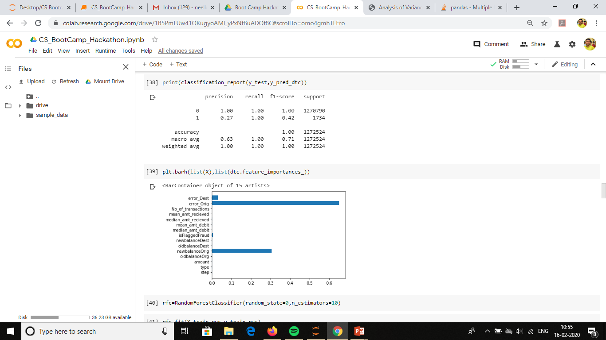
First Decision Tree Model (without cv)

Slide 21
Choice of evaluation metric
The goal of the model is to identify the fraudulent transactions.
The focus is to minimize False Negative predictions (Transaction which are Fraudulent and not predicted as Fraudulent)
Any evaluation metric taking into the “False Negatives” will be a fair deal.
We can choose “Precision score or F1 score ” as model evaluation metric

Slide 22
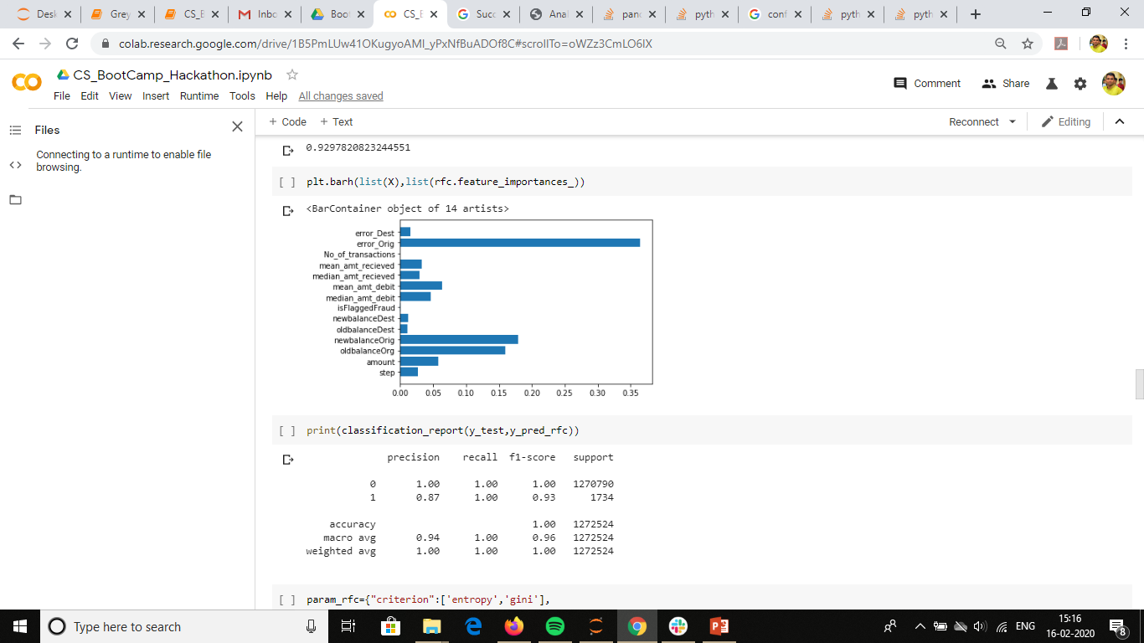
Random Forest Classifier (without CV)

Slide 23
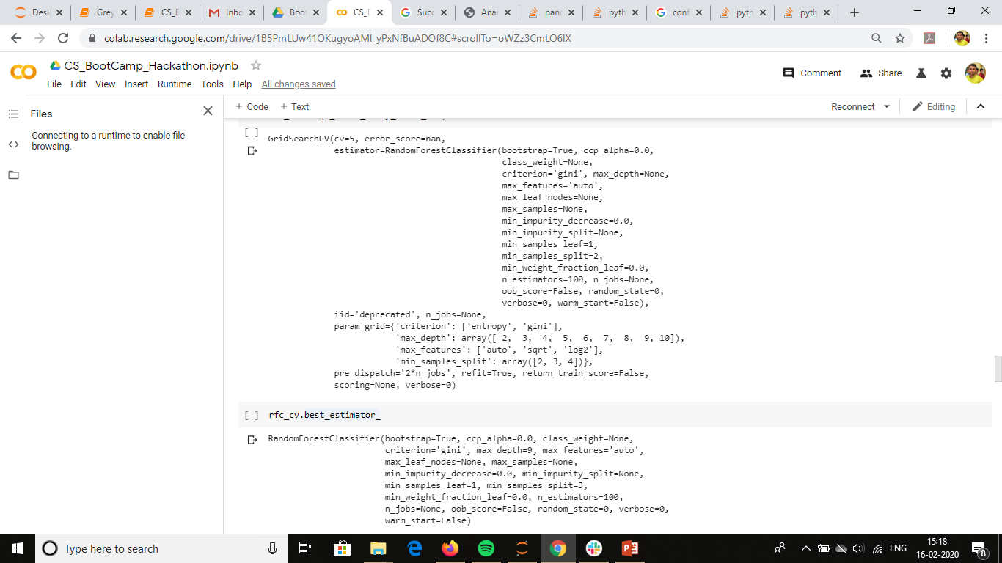
Fine tuning model

Slide 24
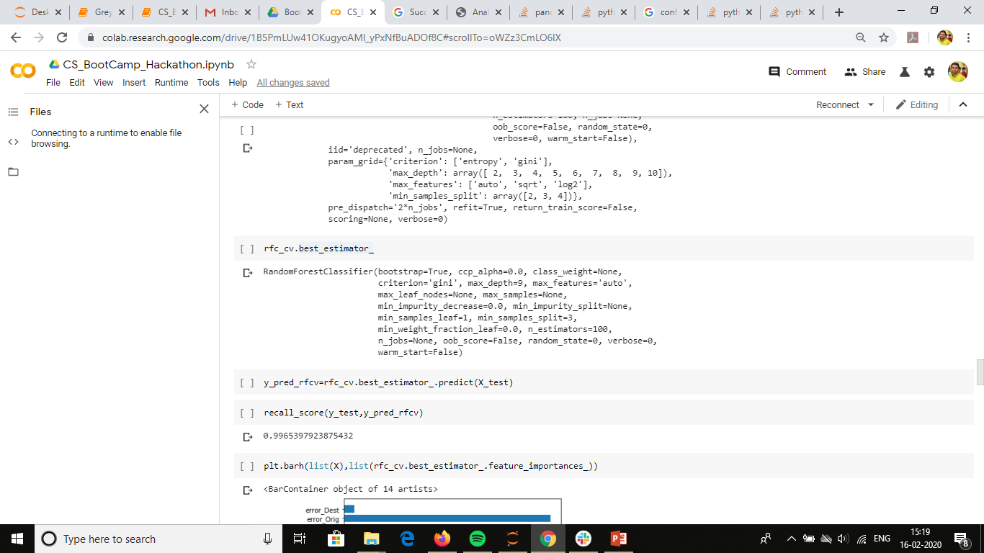
Best Model for random forest classifier

Slide 25
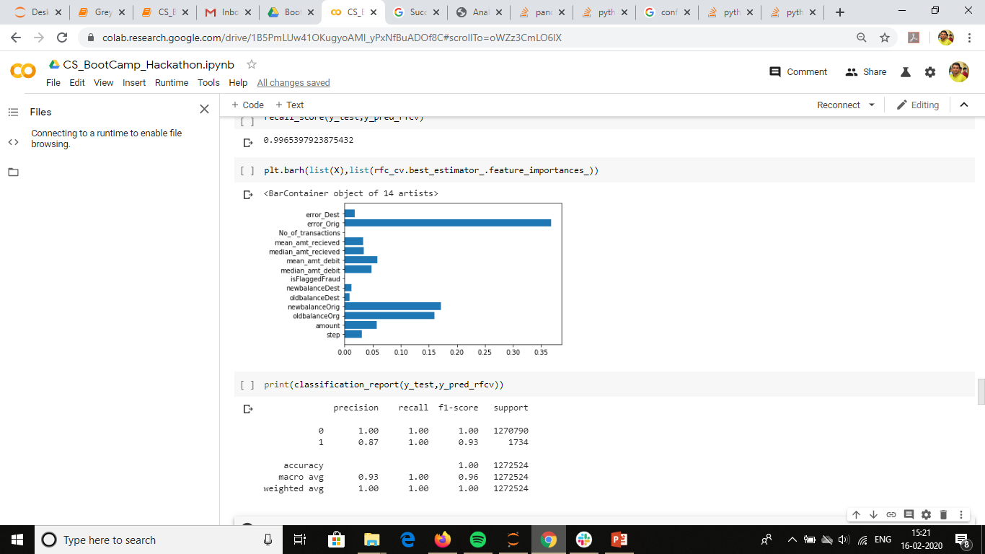
Feature importance with best model of random forest classifier

Slide 26
Insights & Decisions
Better to predict a actual true transaction as fraudulent and send as scrutiny
Focus of Bank should be on accounts which has high balance & high transaction value
Currently the amount of transaction is being drained out of the account in one single transaction , if this pattern changes the model might need to be rebuild
In the real business case, details & implications about type of transaction would have been helpful
Cases where the amount of transaction is ZERO, are negligible and hence ignored
In the NON- Fraudulent transactions, for majority of transactions the difference between balance before and after transaction does not match the transaction amount.
Anomalies wrt customer spending pattern could have been analysed if we had more data
Notes:
What are the top insights you have derived and what are the decisions the business can take?
Don’t focus on findings, focus on the decisions you recommend for the business.
Give a call to action on what the business must do to improve.

